Slide 1


Smart Aquarium
An Intelligent Aquarium Project by-Harshpreet Singh Raju
Student ID: 2410994799

Slide 2
Introduction
Smart Aquarium is an IoT-based intelligent system designed to automate fish care.
It ensures proper feeding, water quality monitoring, and environment control while allowing remote access.

Slide 3
Uses of Smart Aquarium
1. Automatic Fish Care
2. Remote Monitoring
3. Feeding Automation
4. Alerts & Safety
5. Energy & Cost Saving

Slide 4

Importance of Smart Aquarium
1. Fish Health & Survival
2. Convenience for Owners
3. Educational Value
4. Scalability (Fish Farms)
5. Eco-Friendly Operation

Slide 5
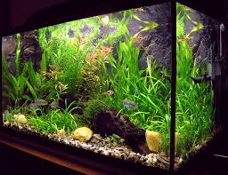
Problem Statement
Many aquarium owners face challenges in maintaining fish health due to improper water quality, irregular feeding, and lack of monitoring. Traditional solutions require manual intervention and constant supervision, which is not convenient for busy or traveling owners.

Slide 6
Objectives
Automate aquarium monitoring and maintenance.
Ensure healthy living conditions for fish.
Provide remote monitoring and control via IoT.
Reduce energy consumption and prevent overfeeding.
Develop a scalable solution suitable for homes and fish farms.

Slide 7
Proposed Solution
Use sensors (temperature, pH, turbidity sensor) for real-time monitoring.
Actuators (heater, filter, air pump) for environment control.
Smart feeder for scheduled feeding.
IoT connectivity for remote access and alerts.
Mobile/PC interface for user interaction.

Slide 8
System Architecture
Sensors: Temperature, pH, Oxygen sensors.
Actuators: Heater, Filter, Air Pump, Smart Feeder.
Controller: Arduino/Raspberry Pi processes sensor data.
Connectivity: Wi-Fi/IoT for remote monitoring.
User Interface: Mobile app or PC dashboard for alerts and control.

Slide 9
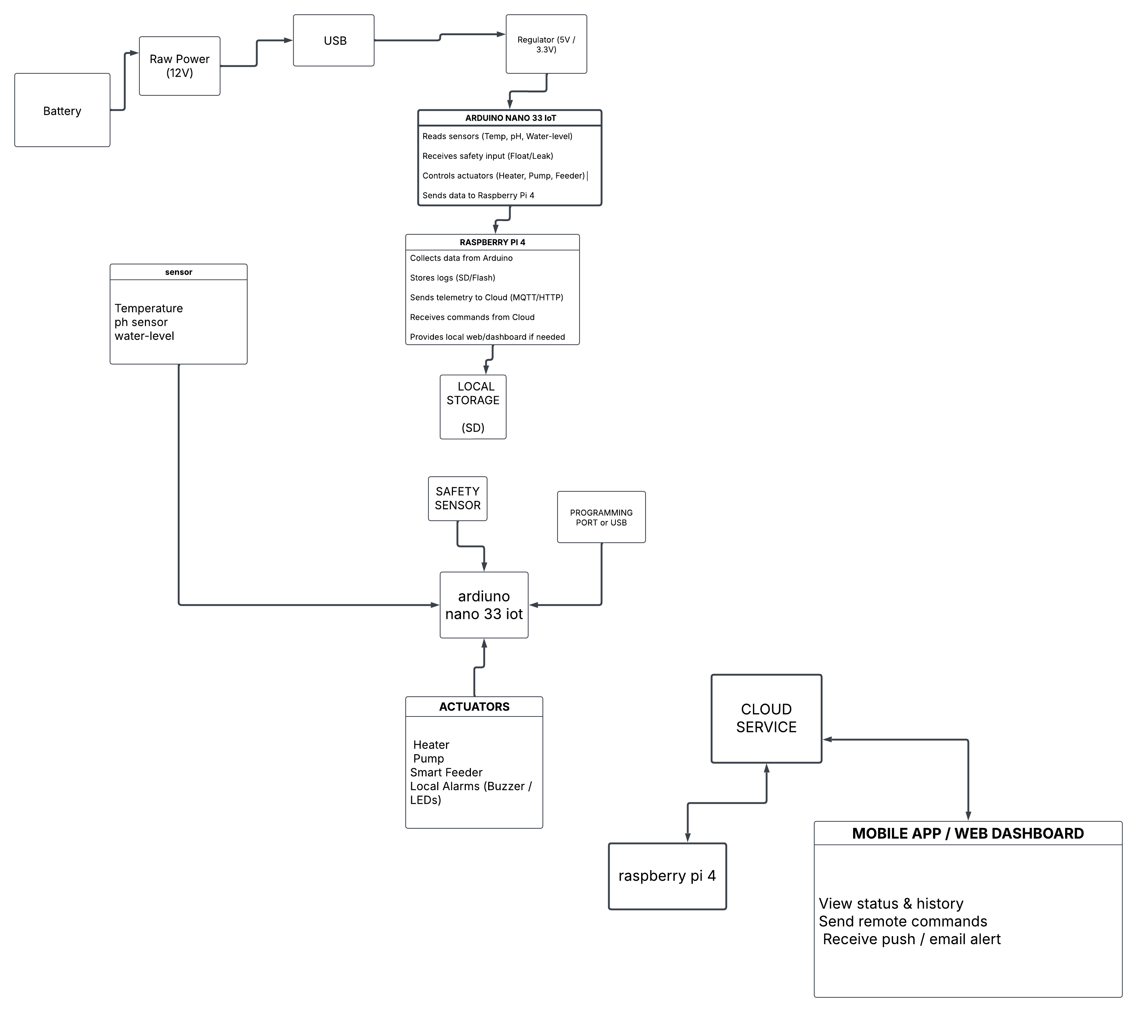

Slide 10

Conclusion
Smart Aquarium ensures fish health, reduces owner effort, and introduces IoT-based smart automation. It is scalable from home use to large-scale fish farms, promoting eco-friendly and cost-effective care.

